Slide 1
Welcome to Sandwell

Slide 2
Your pay, terms and conditions you will receive in Sandwell are negotiated through the trade unions.
This includes your annual leave entitlement, parental leave, working hours, flexible working, sick pay as well as Sandwell’s pay grades.
When it comes to any changes UNISON consults members on whether to accept or reject them. Only members get to vote.
If you want a say over your future pay, terms and conditions, such as the annual pay award, then you need to be a member of a recognised trade union.

Slide 3
The greater the number of UNISON members the BIGGER your collective voice is.
More members = greater bargaining power.
UNISON is the biggest trade union in Sandwell Council.
UNISON is the biggest trade union nationally with 1.3million members.

Slide 4
Members get access to expert advice and support in the workplace. Should you have any problems at work, find yourself in a sickness absence meeting, or find yourself under investigation for any reason, then as a member you can receive direct support and representation.
UNISON can only be there for you if you are already a UNISON member for 4 weeks before you have any issues or problems.
Should you need it, UNISON members will receive legal support for free on work matters.
Members also can phone for 30 minutes free legal advice for non-work related matters too.
You can even arrange a free Will through UNISON.

Slide 5
If you are already a UNISON member from another location that’s great, but you will need to ensure you are part of Sandwell General Branch.
Simply call 07736 923559 or 0121 569 5996 to transfer your membership. Or email us at sandwellunison@btconnect.com

Slide 6
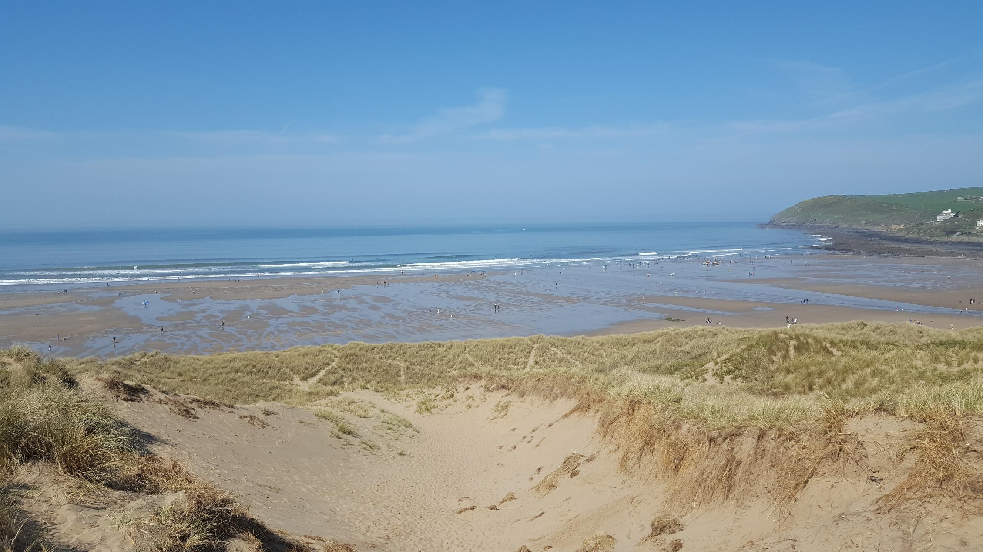
UNISON Members Get Access to the following Benefits:-
Discounted Car insurance with LV
Dental and Health Plans
UIA home, pet and travel insurance
Life insurance
Prepaid Plus Cashback card for savings on everyday shopping
Access to personal finance advice service, including mortgages
UNISON Travel, holiday deals and cruises
Discounts at the UNISON holiday resort in Croyde Bay (pictured)
There for You Fund to assist members in financial hardship

Slide 7
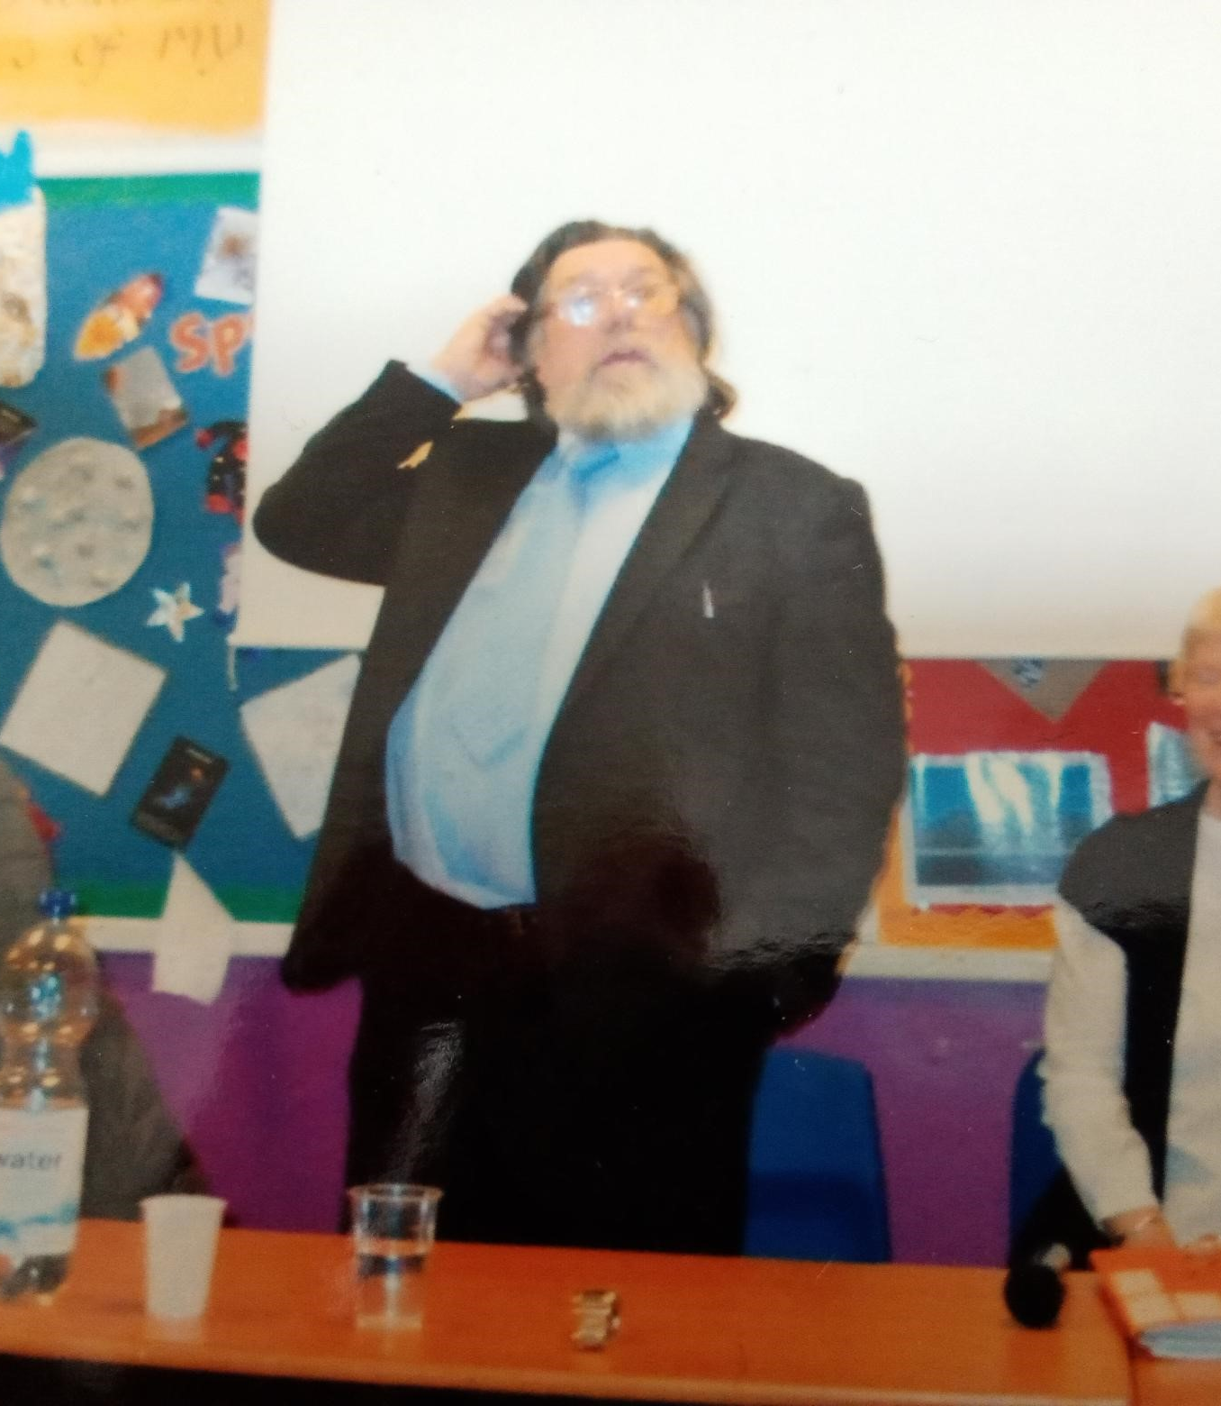
UNISON in Sandwell
Our own Branch with its own resources and activities
Check out the webpage www.sandwellunison.co.uk
Check out Branch Facebook page Sandwell General Branch of Unison | Facebook
Democratic structures that allow members to shape the union branch – we even occasionally have famous guests speakers at our meetings

Slide 8
Let UNISON be Your Friend at Work Join UNISON https://join.unison.org.uk

